Slide 1
Company Bankruptcy Prediction

Slide 2
Dashboard Overview
Content:
Purpose: Analyze Sales, Profit, Cost, and Quantity by Category
Data Source: Company Sales Dataset
Key Metrics: Sales, Profit, Cost, Quantity
Categories: Office Supplies, Furniture, Technology
Visuals Used: Bar, Donut, Line, KPI Cards, Gauge

Slide 3
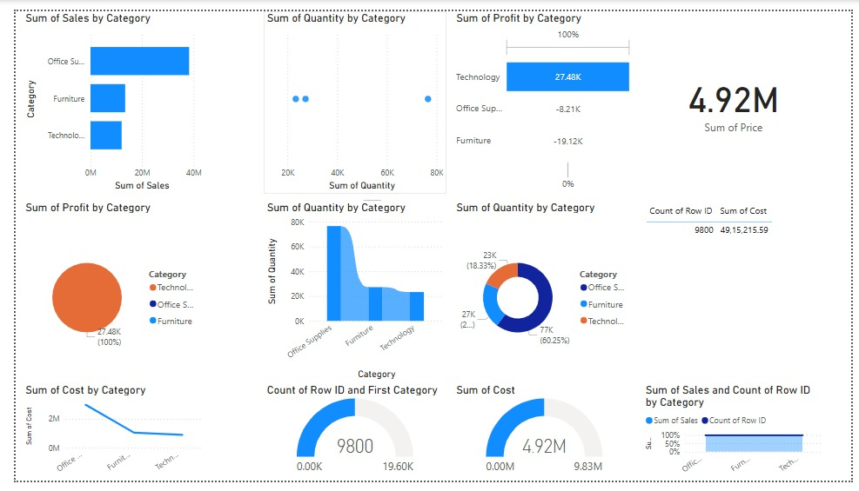

Slide 4
Category-wise Performance
Content:
Office Supplies: Highest Sales and Quantity
Technology: Highest Profit (₹27.48K)
Furniture: Loss in Profit
Use visuals: Screenshot of bar/pie charts from dashboard

Slide 5
Business Insights from Dashboard
Content:
Technology has good profit margin despite lower sales
Office Supplies bring volume but lower profitability
Furniture needs cost control or strategy change
Overall sales = ₹4.92M; Records analyzed = 9800

Slide 6
Recommendations
Content:
Focus on selling more profitable Technology products
Review and optimize costs in Furniture category
Analyze Office Supplies pricing strategy
Keep tracking KPIs like Profit Margin and Cost Trends

